Slide 1
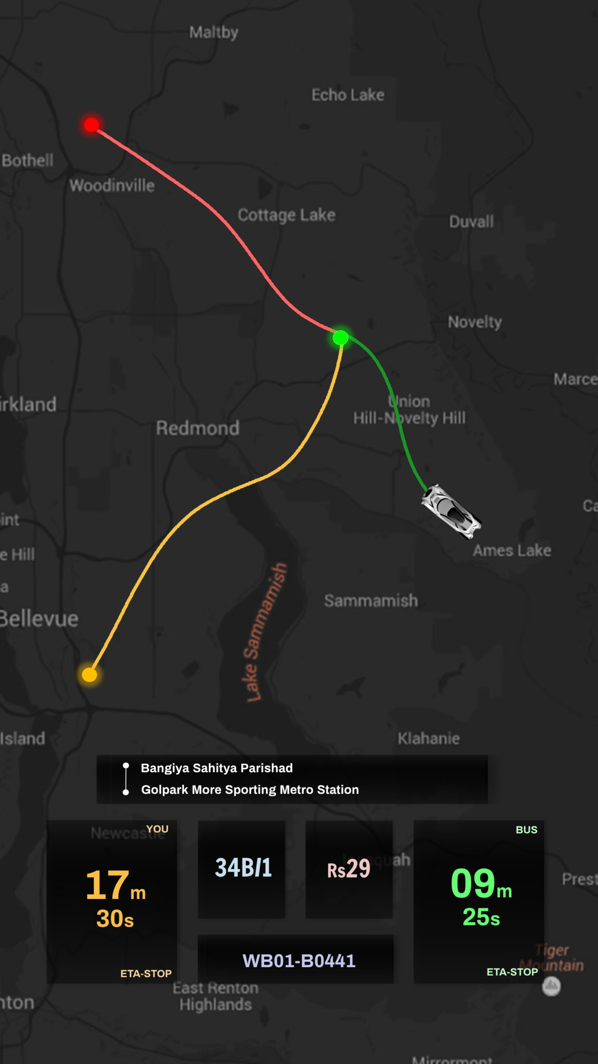
TO
FROM
USER
BUS
FROM
TO
BUS ROUTE
FARE
USER ETA to “FROM”
BUS ETA to “FROM”
BUS ID

